Slide 1
PROMOTION REPORT
Upgrade Factory Operation Support System (FOSS) &
Make Asset Life Cycle Management System
MAIN CONTENTS
1
Job History & Achievement
Page 1
2
Background Of Activities
Page 2~3
3
Total Improvement Schedule
Page 4
4
Detail Improvement Activity
Page 5~7
5
Confirm result & Next activities
Page 8~9
Presented by : Nguyen Nhu Minh
Join Date : 12-Feb-2019
Current Position : Officer (5 years)
New Position : Supervisor
Section : DEV
Notes:
0.5m
Good morning/afternoon/evening everyone,
My name is Minh ,member of IT section. Today, I am very honored to be here to present my promotion report.
My topic is : “Upgrade Factory Operation Support System (Foss) & Make Asset Life Cycle Management System”
My presentation have to 5 parts.
Let’s begin: I talk about my self.

Slide 2
Job History & Achievement (2109-2023)
2/10
1/9
1.Job History & Organization:
Time | Career History
Entrance | 12/02/2019
Apr 2022 | Rank up (V12-V13)
My Responsibilities | ✓Develop software. ✓Support users and all systems of IT.
ISD (GM. Matsushita)
M. (Chung/ Thuy/ Toan)
AM. Hien
Sup. Minh
4HC
4HC
2HC
6HC
Develop
Sap
Infra
Business Planning
2.New Assignment:
Analysis
✓ Current job : Maintain developed Systems, Analyse, Design & Develop new systems, study system of company production to make software.
✓ Change mindset : Lead team (2 officers) beside my current jobs. Study more new technologies to develop software.
3.My main achievements (2019 – 2023)
❖ Reduce HC
Auto transfer kitting to SAP(2pax)
QC & MCS Free Location(2pax)
Auto print Stock card by Mobile printer for MCS(2pax)
❖ Save cost
Tally sheet for SCM (33.6K$)
Manage sub-material(16.8K$)
Sound Biz Adding Serial Outer & Shipping control (7.8K$)
❖ Ensure Quality
Develop weight check system
Modify printing label system
Check Double ID, PL, shipping for all production line
Notes:
0.5m
Now, I introduce about my self.
I work here start February, 2019
We see in the ISD Organization, I’m working in Develop team. There are 4 peoples in my team. I’m a in charge of Software development.
New assignment after promotion: …
There are some my achievement. I had done many project with achieve cost down, reduce HC, ensure quantity for production.

Slide 3
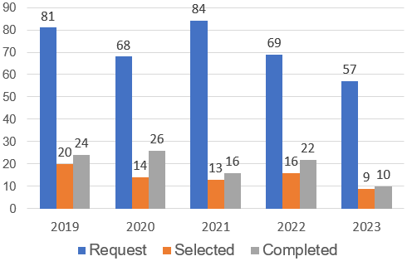




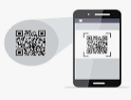





Background Of Activities Theme (1)
2/10
2/9
My Goal
Increase development time ratio, reduce time support to get more cost down.
Select smart devices, new technology to upgrade WinCE.
Transition In The Number Of Project
Development Activity
Target: Increase quantity project
Actual: Development time is still not enough
OS/ PLATFORM
45 % Normal support
55 % Development
HANDY TERMINAL
END OF LIFE 2023
Scan
Normal support is very height (45%)
New technology ?
Theme 1: Upgrade Factory Operation Support System (FOSS)
Current System
Development Software is quite slow
OS is not update in the future
Not responsive to big data system
The stable of the device is poor, often repaired
New System
New language & new OS
Make new software
Large memory, easy to develop functions
More faster, stable, beautiful interface
Mission: Reduce support time, increase development time and comply policy
Notes:
(1m)
The next, I talk about the background of activities.
- Let's look at the Transition In The Number Of Project. IT received a lot of number request . There is small of request is selected..
Our Target : increase quantity project but actual the develop time still not enough.
Normal support is very height because all application on Handy terminal is running wince. Difficult to develop soft on them. Take long time to modify and build program. Sometime repair and setup Operation system when error. (There are a lot of software need support during operation. human error, machine error, or system error. I need to solve it for the system running again..)
other reason, Win CE end of line 2023
this is reason I selected them1: upgrade FOSS From wince to other OS.
My action: …
Next slide, I talk about the background issue 2.

Slide 4
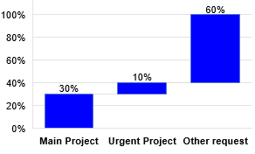

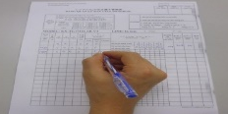

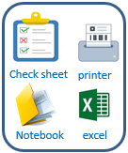
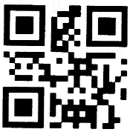
Background Of Activities Theme (2)
2/10
3/9
My Goal
Build standardization for asset management system.
Save time to inventory, reduce manual job, papers and ensure quality.
Ratio of development team projects
Current Asset Management IT
Solution
Other Request
Improve quality
Manual job
No software
Not clear process
Use Excel manage equipment
To Inventory PC by Paper
Manage Equipment by barcode
Analysis
Theme 2: Make Asset Life Cycle Management System (ALCMS)
Current process
 | Quantity | Time inventory / month (hours)
Stationery Item | 490 | 24.5
Infra Equipment | 652 | 32.6
Improve activities
Good receipt
Database Server
Use software
Scrap
Transfer
Manual job, waste papers.
Take time to inventory.
Difficult control in-out.
Easy mistake.
Not ensure quality.
Save time management & ensure quality.
Reduce papers.
Easy manage operation and trace history.
Inventory
Maintenance
Notes:
(1m)
- we are look at the ratio development team project:
Annually, we must complete is 30% main project following KPI, in addition to 10% of urgent projects . The rest of request is 60% from other departments. These are thing that we haven’t enough time to complete. Its content of other request related to:….
in other request include our improvements -> An example of other request, we look at the Current Asset Management IT: there are a lot of manual job, excel file and check sheet, papers.
For this reason, I select the theme 2 make an new system
This is general asset management process , specially IT equipment have more 1 thousand items need to be managed.
My action : using by barcode technology, scan barcode auto save database server
Apply new system, We save time management, reduce papers.
3minute/60*490 = 24.5h
3minute/60*652 = 32.6h
total: 57.1h

Slide 5
Total Improvement Schedule
1/10
4/9
Theme | Items | Activity Content | In charge (Main) | WHEN (Jul.2023) |  |  |  | TARGET
 |  |  |  | Q1 | Q2 | Q3 | Q4
Upgrade FOSS | [1] Upgrade FOSS from WinCE to other OS. [2] Analyze & Optimize all process of FOSS |  Select new language & new OS to develop.  Select smart device to scan barcode. | IT member |  |  |  |  | Deciding on a new language
 |  |  GR local  GR Oversea | IT member MCS Pic |  |  |  |  | Upgrade all function to new OS
 |  |  Storing | IT & MCS
 |  |  Kitting & Supply | IT member MCS Pic
 |  |  Kitting Other  Temporary Location | IT member MCS Pic
Make Asset Life Cycle Management System | [1] Standardize the asset management process of IT. [2] Develop software to manage asset |  Borrow & return Equipment | IT member |  |  |  |  | Apply software to save time management, reduce papers
 |  |  Manage stationery warehouse | IT member
 |  |  Good Receive | IT member
 |  |  Inventory, Transfer, Scrap, Maintenance | IT member
Plan:
Actual:
Notes:
0.5m
Next slide, I talk about the total improvement schedule
the theme 1, upgrade to FOSS from win CE to other OS.
[2] analyze and optimize all process of Foss -> develop all functions-> target :…
The theme 2: [1] Study management asset -> standardize all process -> clear all functions.
After that , I select the device and develop software. -> target : ….
Next slide, I will explain more detail for issue 1.

Slide 6
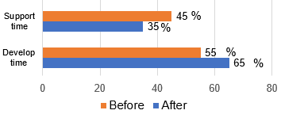
Detail Improvement Activity Theme (1)-1
1/10
5/9
Follow company policy, OS WinCE will be end of life 2023.
Upgrade Foss from WinCE to new OS as mobile.
Current Issue
Solution
Applications are running on WinCE.
Normal support time is very height.
Select new language & new OS.
Make new software upgrade FOSS.
Select new language & new environment
➢ Flutter develop applications for mobile devices runs on both Android and IOS.
➢ Android OS is quite commonly and integrates many scanning devices.
Limit WinCE
Flutter & Android Efficiency
❖ Difficult develop for big system.
❖ Take a long time to support when error.
❖ Poor memory, catch poor signal WIFI.
 Increase develop time.
 Reduce support time.
 Make faster, stable, smarter Software.
Target
Compliance company policy
Total devices need to Upgrade:
MCS Department : 109 pcs
Other Department : 6 pcs
Notes:
1m
About theme 1, Follow company policy, Windows CE will be end of life 2023.
Current situation:
All Applications are running on Wince
Normal support is very height
Solution:
- Select new language & new OS -> develop new software
upgrade FOSS => reduce support time.
My action :
I have choose Flutter language. Because it is used to develop applications for mobile devices. Runs on both Android and IOS platform, desktop applications and web applications. (Develop software slow, Not responsive to big data system, Regularly repair and setup window again)
The Android OS is quite commonly used and integrates many scanning devices. So that I have selected android platform.
- Limit Wince : …. => The advantage when use flutter to develop software: make faster, stable software.
Result : let look at total devices need to upgrade new software. MCS department : 109PCS, other department: 6 pcs
Now I go to the functions detail of FOSS.
Improvement result after upgrade:
- Increate develop time , reduce support time

Slide 7

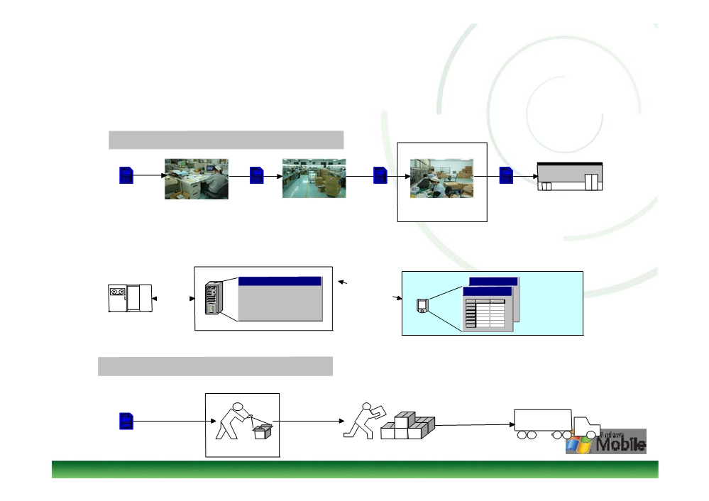
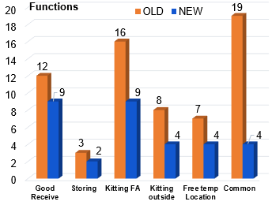




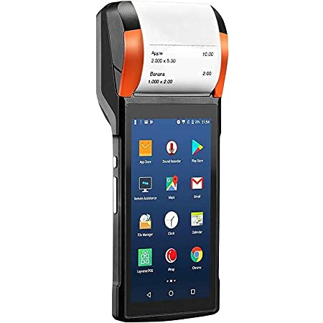
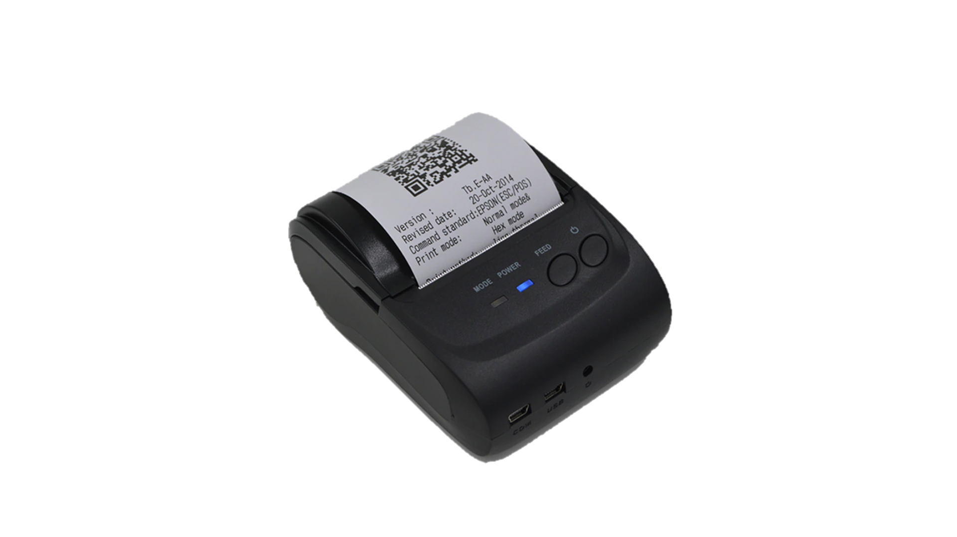

Detail Improvement Activity Theme (1)-2
1/10
6/9
Analyze & Optimize FOSS process.
Develop new software and upgrade on new devices.
Current Issue
Solution
Analyze all Process of FOSS
A lot of functions (65 functions).
There are many similar functions.
Many request improvement quality from the department.
❖ Improve & Optimize FOSS system
Analysis deeply and optimize all process.
Combine the same functions.
Discuss and clear process to develop software.
Develop Factory Operation Support System
Total Function FOSS
Barcode
HT device
Mobile device
FOSS
DB Server
WIFI network
New software
Result upgrade
❖ Merits:
 Coding time: 65%
 Support time: 35%
 | Old | New
Total Functions | 65 | 32
Notes:
1m
Next slide, I talk a bout the detail of development FOSS
Current situation:
- There a lot of functions (65 screens)
- There are many similar functions
- Many request improvement quality activities from the department
Solution: Improve & Optimize system
Action : discuss deeply with member department for optimize an minimize all function, the next we develop new software to upgrade from the old devices to mobile device.
Here the Result:
Total function reduce 65 to 32. (-> Amount of working is big to develop. Research new technology to apply and own.)
- Support time reduce 35%.
Now, I move to next theme 2,

Slide 8




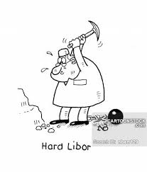

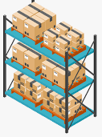




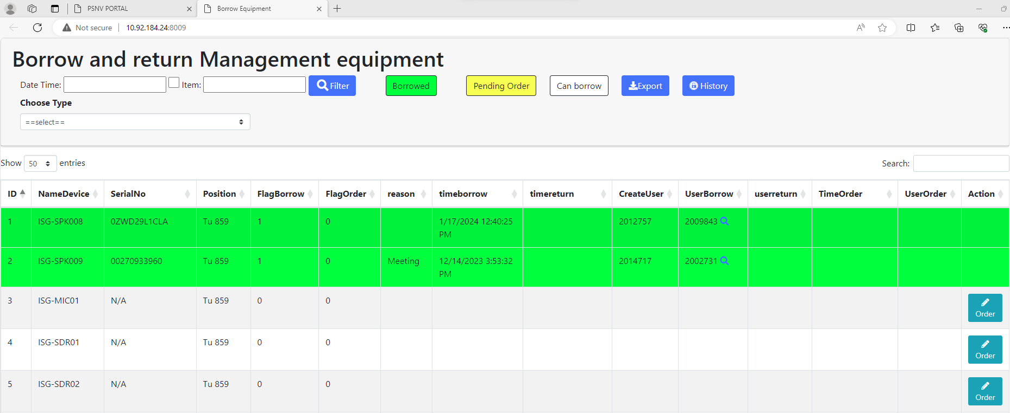
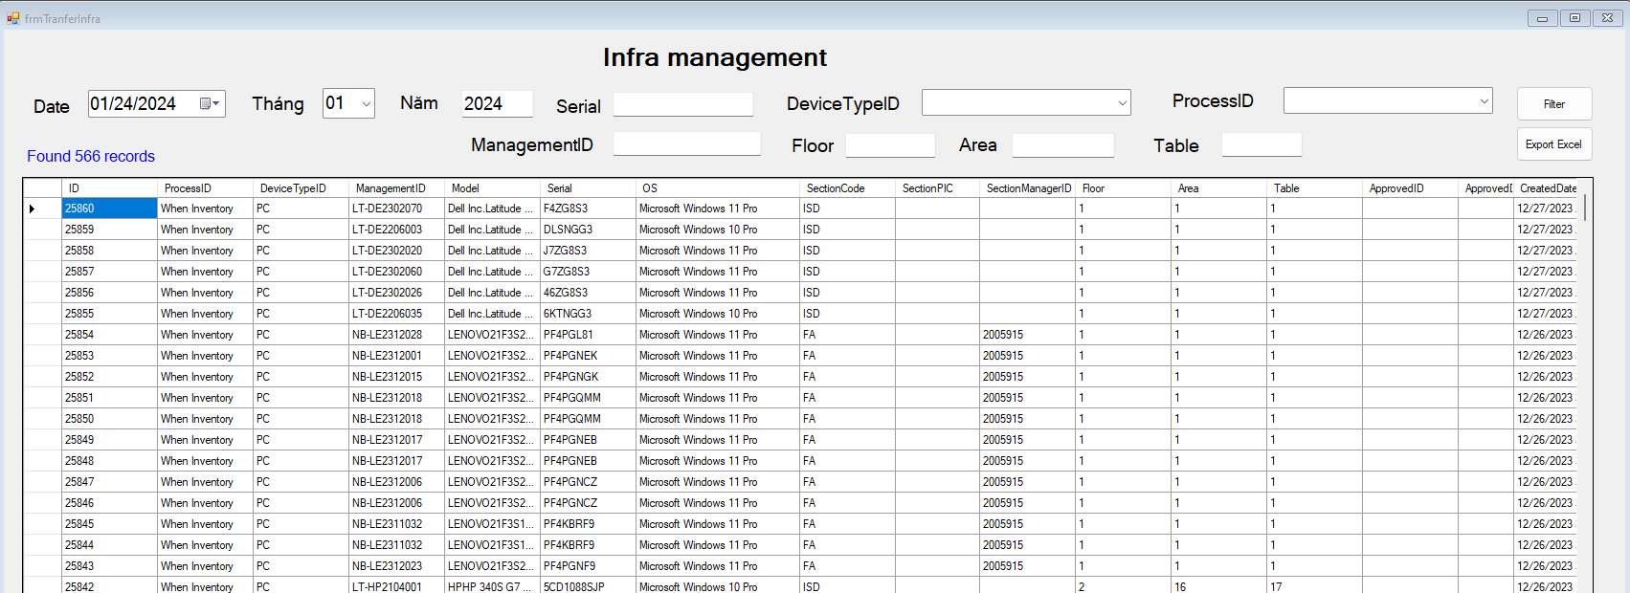
Detail Improvement Activity Theme (2)
1/10
7/9
Standardize the asset management process of IT.
Develop software to manage Asset of IT.
Current Issue
Solution
Too much manual job, papers, excel file.
The equipment is not barcoded.
Take a long time to inventory, make report and trace history.
Survey all process, analysis and design.
Make tool create barcode.
Build standard process of manage asset to develop software.
Goal: Standardization all manual operations
Manual check
IT
User
Monthly inventory PC
Monthly transfer equipment
IT
Borrow & return
Stationery warehouse
Auto report & visualization system
Merits
software
Visualize
Auto Report
100%
Paper
80%
100%
Time
66,7%
20%
33,3%
Database
Reduce paper: 80%
Save time inventory: 66,7%
Apply software to management asset, save time inventory and reduce papers
Notes:
1m
This slide I explain the detail activities of issue 2:
Current situation:
Too much manual job, papers, excel file
The equipment is not barcoded
Take a long time to inventory, make report and trace history.
Current situation:
Survey all process, analysis and design
Make tool create barcode => Issue barcode to identify equipment
Build standard process of manage asset, develop software.
Action: These are 3 main function ,I focus on developing (handling)
Apply scan barcode for each step reduce paper and manual job, check sheet and excel file.
- When borrow & return equipment scan item & user ID card replace record paper. (delete)
- When transfer or inventory scan user's card to identify and fix location replace count manual pc. (delete)
- With stationery warehouses, input and output items, have to scan barcodes to control them. (delete)
=> After scan barcode -> Data result auto save database server via access point. Reports auto visualization on website.
Merit :
Apply this system, you will control easy equipment and specially we will save 60% time management and 80% print paper.
In the future expand other department.
The next slide to confirm result.

Slide 9
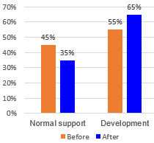
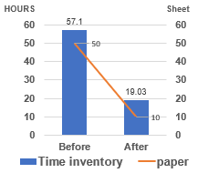
Confirm Result
1/10
8/9
Theme 1: Upgrade Factory Operation Support System (FOSS)
Function
Target
Status
Result
GR local & GR Oversea
Storing
Kitting & Supply (FA,DIP)
Kitting Other
Temporary Free Location
Apply 10/2023
Apply 01/2024
Apply 01/2024
Apply 02/2024
Apply 02/2024
Complete
Complete
Complete
Complete
Complete
35 % Normal support
65 % Development
Theme 2 : Make Asset Life Cycle Management System (ALCMS)
Function
Target
Status
Result
Borrow & return equipment
Complete
Apply 12/2023
Apply 01/2024
Manage stationery warehouse
Complete
Good receive, Transfer, Inventory, Scrap, Maintenance
Apply 02/2024
Complete
Notes:
0.5M
Following the schedule:
Issue 1:…
Result: normal support reduce form 45 -> 35, develop time increase 55 -> 65
Issue 2:…
Save time inventory: 1142 Hour => 380h, Reduce paper : 50sheet -> 10sheet
======== // calculator // ======
Inventory pc:
Before: total time using: 3min/60*1142 pcs =57.1 Hour / month
After: 1min/60*1142 pcs = 19.03 Hour /month
Total paper using : before = 70ram, after = 10ram

Slide 10
Next Activities
1/10
9/9
For my team
For myself
- Training: Support skill, Training skill, coding skill, analysis skill.
- Work team: Learn, sharing, knowledge, experience about new technical. Transfer some system to other member.
- Goal: Make stronger development team.
- Study: Method issue and solved problem, Level up Communication skill.
- Job: Control schedule to keep on time support user, own new technology.
- Goal: Continuously to discuss find out best solution to save time & reduce human for production, ensure quality.
Next activities in 2024
NO | Action plan | FY23 |  |  | FY24
 |  | 1 | 2 | 3 | 4 | 5 | 6 | 7 | 8 | 9 | 10 | 11 | 12 | 1 | 2 | 3
1 | Complete upgrade FOSS to mobile system.
2 | Upgrade Fire extinguisher management system to mobile.
3 | Upgrade Stationery warehouse management system for GA.
4 | Expand ALCMS to other department.
THANK YOU FOR LISTENING!
Notes:
1m
The last slide I talk about the next activities:
For my team: learning, sharing, knowledge, experience for other member -> My goal :….
For myself: study method issue and solve problem, control schedule keep on time. Find the best solution to save time…
Next activities: ….
That all my report. Thanks for your listening!
If do you have any question, please let me know?

Slide 11
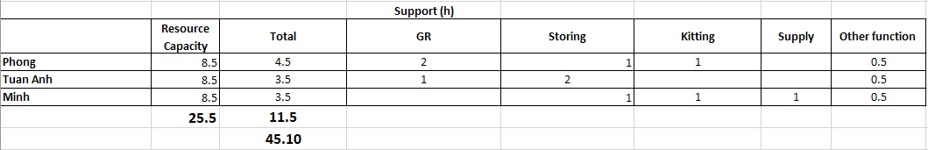



Normal Support Time & Development Time
Total time support of Development team
Total working time : 8.5h/Day
Old System
New System
After combine and optimize function, we can support more quickly (reduce 0.85h/day).
Then we transfer 0.85h saving to develop more systems.

Slide 12
Time Check Inventory Per Month
Before | Quantity | Takes Time for unit (h) | Frequency/ moth (times) | Total take time (H/M) | Total take time (H/Y)
Stationery | 490 | 3/60 | 1 | 24.50 | 294.00
Infra Equipment | 652 | 3/60 | 1 | 32.60 | 391.20
 |  |  |  | 57.10 | 685.20
After | Quantity | Takes Time for unit (h) | Frequency/ moth (times) | Total take time (H/M) | Total take time (H/Y)
Stationery | 490 | 1/60 | 1 | 8.17 | 98.00
Infra Equipment | 652 | 1/60 | 1 | 10.87 | 130.40
 |  |  |  | 19.03 | 228.40
Reduce papers: 480 sheet ~1gram/Year
Before: 50*12 = 600 sheet /1 year
Efficiency | 38.07 | 456.80
After: 10*12 = 120 sheet /1 year
 | (B)Paper/ month | Paper/ month
Hai (Inventory) | 20 | 5
Infra (Transfer, Inventory,…) | 30 | 5
Total | 50 | 10

Slide 13
ROI Of Make Asset Life Cycle Management System
Item | Qty | Total (hours) | Amount / Year (USD)
Paper | 1 gram |  | 2.5
Scan Barcode Device | 1 pcs |  | 625
1 Develop (1,5h/day) | 5 Month | 180 | 720
 |  | Total investment | 1347.5
Efficiency
 | Time | Amount / Year (USD)
Total Inventory (H/M) | 38.07 | 152.28
Total Inventory (H/Y) | 456.8 | 1827.2
Total Investment | Efficiency/M | Efficiency/Y | ROI /Y
1347.5 | 152.28 | 1827.2 | 0.737467163

Slide 14
ROI Of Upgrade FOSS
 | Qty | Total (hours) | Amount / Year (USD)
Scan Barcode Device | 115 pcs
Minh (DEV 5h/day) | 8 Month | 960 | 3840
PHONG (DEV 5h/day) | 8 Month | 960 | 3840
Hien (Training 2h/day) | 2 Month | 96 | 384
 |  | Total Investment | 8064
 | Before (hours) | After (hours) | Efficiency (hours) | Total support/Day
Normal support time | 3.83 | 2.98 | 0.85 | 2.55
Total Investment | Efficiency/M | Efficiency/Y | ROI /Y
8064 | 244.8 | 2937.6 | 2.745098039

Slide 15
Total function Develop FOSS
Function | Old system | New system
Good Receive | 12 | 9
Storing | 3 | 2
Kitting FA | 16 | 9
Kitting outside | 8 | 4
Free temp Location | 7 | 4
Common | 19 | 4
Total | 65 | 32

